Slide 1
Matching school attendance boundaries with schools from CCD dataset

Slide 2
Datasets
School attendance boundary: sdatt08.shp for MN (Shape file data)
Census School district boundary: tl_2009_unsd_MN (shape file data)
Census Blocks
CCD data for your state: CCD200708MN (tabular data with lat, long fields)
School attendance boundary data located at:
School district boundary data located at:
CCD data located at:
Please copy data in your folder to work, keep base data in one folder, and processed data in another folder, so you can get started from the base datasets in case of a mistake.

Slide 3
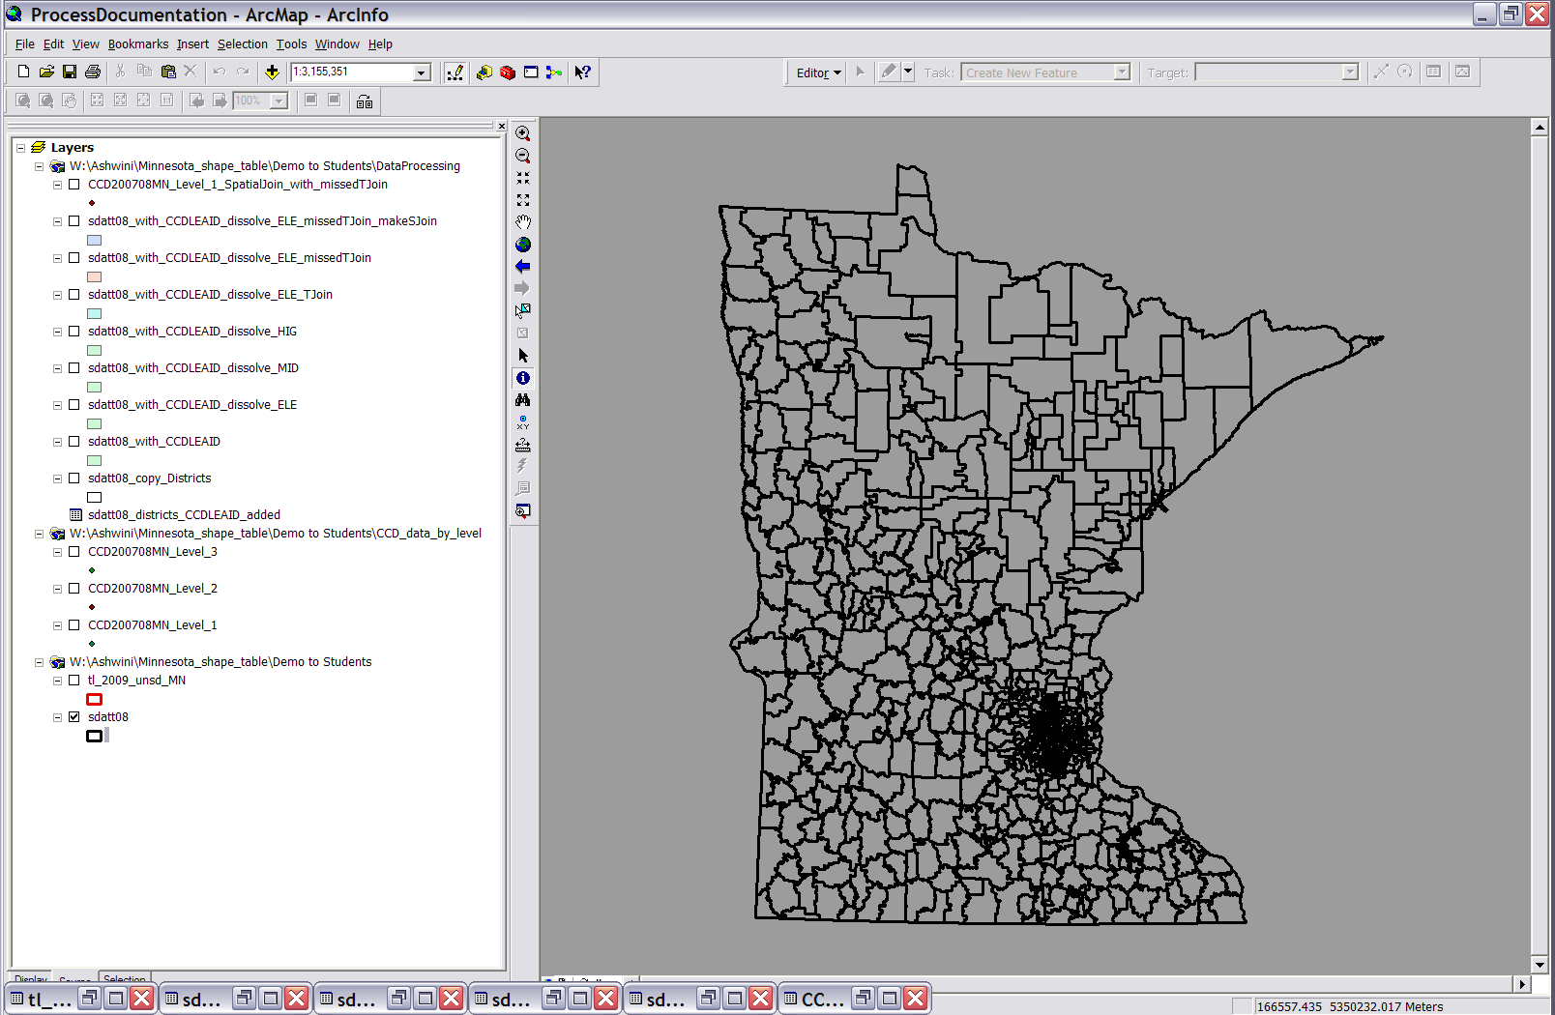
Datasets: School Attendance Boundary

Slide 4
Datasets: Census Geography

Slide 5
Datasets: CCD data

Slide 6
Objective
We would like to match one school attendance boundary polygon with one school record (point) from the CCD data.
We can approach this with a spatial join of CCD points and school attendance boundary polygons, however in cases where multiple points (schools) fall within one school attendance boundary, each case will have to be reviewed individually to figure out which school should be associated with that school attendance boundary.
Alternatively, we have names of schools recorded in the CCD data as well as in the school attendance boundary data, and therefore, we can join schools with school attendance boundaries based on names using a tabular join. Those schools that do not get joined based on name alone, can be joined using a spatial join.
After performing the spatial join if there are any cases where more than one school falls within a single attendance boundary, then we will review those manually on a case by case basis.
School attendance boundary
CCD data
Join of CCD with a boundary
Tabular join → review cases with no tabular join → use spatial join on cases with no join → review cases with no spatial join → manually correct any errors that are found

Slide 7
Data Preparation: CCD data
Obtain CCD data for your state, for the selected year from appropriate folder.
Create shape files from the CCD data by adding XY data in the ArcMap. Select lat field for the Y axis and long field for the X axis, and the NAD 83 geographic projection. You could also import projection information from the CCD shape files used in my work.
Divide CCD data by level (Elementary, Middle, High, Charter, Magnet schools) based on following criteria. Use Select by Attribute query for selection and export selected features to create new shape files.
Magnet: MAGNET07 = 1
Charter: CHARTER07 = 1
Elementary: LEVEL07 = 1
Middle: LEVEL07 = 2
High: LEVEL07 = 3
** Note that numbers “07” in the field names indicate year of the CCD data, which may vary for your particular case.

Slide 8
Data Preparation: Census Geography
Obtain census geography district dataset for the entire nation, and create a subset of the data for your state, using a select by attributes query, on the field STATEFP. Ex. STATEFP = 27 for retrieving all the records for MN. Export selected features.
To get census blocks do the same, filter out relevant blocks for your state by using a select by attributes query. Export selected features to form a new dataset.

Slide 9
Data Preparation: School Attendance Boundary
0. Ensure that the school attendance boundaries conform to the census blocks
Census Blocks (Poly)
Feature to Point
Census Block Pts (Pts)
Spatial Join
School Attendance Boundaries
Output
Census Block Pts _SJOIN_ boundaries
Delete unnecessary fields & Attribute Join (join field census FID)
Census Blocks (Poly)
Census Block Pts _SJOIN_ boundaries
Export joined file
School Attendance Boundaries
that conform to blocks
Census Blocks w FID of school attendance boundaries (Poly)
Dissolve on FID_2 School Attendance Boundary FID is named FID_2 in joined table

Slide 10
Data Preparation: School Attendance Boundary
If you are following method 1, then dissolve school attendance boundary dataset on field “sdnum” or “School district name” to obtain school district boundary dataset.

Slide 11
CCD Data: School points
Tabular Join
School attendance boundaries
Method 1
SchoolDistrictNumber_SchoolName
(Join field)
1. Formation of the join field: SchoolDistrictNumber_SchoolName
CCD data: Unique school district number field LEAID
School attendance boundary data: Unique school district number field SDNUM
** Match SDNUM numbers with LEAID numbers.
School attendance boundaries
School districts dataset
Tabular Join
Census school district dataset (has LEAID field)
Dissolve
SchoolDistrictName: SDNAME, NAME
(Join field) Use Script
SDNUM
(Dissolve field)
Export
Export joined table, it has SDNUM and LEAID fields.
School attendance boundaries
Tabular Join
SDNUM
(Join field)
Export
2. Segregate CCD data and School attendance boundary data by level. Elem, Mid, High ~ Level 1, 2, 3
CCD Data: Level 1
School attendance boundaries : Elem (has LEAID field)
Tabular Join for elementary ~ level1
SchoolDistrictNumber(LEAID)_SchoolName
(Join field) Use Script

Slide 12
1. Formation of the join field: SchoolDistrictNumber_SchoolName
Method 2
CCD data: Unique school district number field LEAID
School attendance boundary data: Unique school district number field SDNUM
** Match SDNUM numbers with LEAID numbers.
Census school district polygons (has LEAID field)
Feature to Points
Census school district points (has LEAID field)
School attendance boundaries
Spatial Join
Census school district points (has LEAID field)
Output
School attendance boundaries_SJOIN_Census school district points (has LEAID)
Delete unnecessary fields, Add 3 fields, calculate in it values LEAID_SCHOOLNAME(ELE)…
School Attendance Boundaries with LEAID_SCHOOLNAME
2. Segregate CCD data and School attendance boundary data by level with dissolve. Elem, Mid, High ~ Level 1, 2, 3
CCD Data (Level 1) with
LEAID_SCHOOLNAME Calculate values in new field)
School Attendance Boundaries Elementary with LEAID_SCHOOLNAME
Tabular Join for elementary ~ level1
SchoolDistrictNumber(LEAID)_SchoolName
(Join field) Use Script

Slide 13
2. Segregate CCD data and School attendance boundary data by level with dissolve. Elem, Mid, High ~ Level 1, 2, 3
CCD Data (Level 1) with
LEAID_SCHOOLNAME Calculate values in new field)
School Attendance Boundaries Elementary with LEAID_SCHOOLNAME
Tabular Join for elementary ~ level1
SchoolDistrictNumber(LEAID)_SchoolName
(Join field) Use Script
Export all records
CCD dataset with tabular join from school attendance boundaries
3. Processing of the records that didn’t get joined in the tabular join
CCD dataset with tabular join from school attendance boundaries
Export records with no join
CCD dataset with no join records only
CCD dataset with no join records only
Spatial join
School attendance boundary dataset
Spatial joins conducted both ways, let us examine join count values wrt each dataset, and overlaying one on top of another helps identify incorrect (join count 0 or more than 1) joins.
School attendance boundary dataset
Spatial join
CCD dataset with no join records only

Slide 14
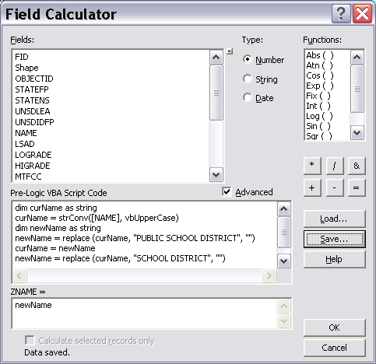
Field Calculator
Select “Advanced”
Select “Load” and open appropriate expression file (*.cal)
Select “Save”, and save the expression for future reference
Put the output variable name in this box.
Select “OK” to execute the field calculation command.

Slide 15
Description of a VBA script
strConv Function
curName = strConv([NAME], vbUpperCase)
This function converts the selected string in the specified character case. In this case selected string is the value present in the [NAME] field, and the constant vbUpperCase specifies conversion of the string in Upper Case. Final value is stored in the curName variable.
Value Assignment
curName = newName
In this line value in the variable newName is put in the variable curName.
Replace Function Syntax: Replace(expression, find, replace) newName = replace (curName, "SCHOOL DISTRICT", "")
In this line the replace function searches the string stored in
variable curName, and if the specified find value “SCHOOL DISTRICT” is found, then the function replaces it with the specified replace value, which in this case is a null string “”.
Trim Function newName = trim (newName)
Trim function removes spaces from left and right side of the specified string. In this case the trim function removes any space characters present at the beginning or the end of string value stored in the variable newName. The final value is stored in the variable newName, and the old value present in variable newName is overwritten.
Example of a script file executed on school district names (census) in the ZNAME field
dim curName as string
curName = strConv([NAME], vbUpperCase)
dim newName as string
newName = replace (curName, "PUBLIC SCHOOL DISTRICT", "")
curName = newName
newName = replace (curName, "SCHOOL DISTRICT", "")
curName = newName
newName = replace (curName, "PUBLIC SCHOOLS", "")
curName = newName
newName = replace (curName, "AREA SCHOOLS", "")
curName = newName
newName = replace (curName, "AREA SCHOOL", "")
curName = newName
newName = replace (curName, "SCHOOLS", "")
curName = newName
newName = replace (curName, "AREA", "")
newName = trim (newName)
Variables
dim curName as string
curName and newName are variables used to contain text type of data. String word specifies text data type of the variable.

Slide 16
VBA script used on the SCHNAM field in CCD data Level 1
dim curName as string
curName = StrConv([SCHNAM07], vbUpperCase)
dim newName as string
newName = replace (curName, "ELEMENTARY SCHOOL", "")
curName = newName
newName = replace (curName, "ELEMENTARY", "")
curName = newName
newName = replace (curName, "TARGETED SERVICES", "")
curName = newName
newName = replace (curName, "TARGETED SEVCS", "")
curName = newName
newName = replace (curName, "TARGETED SERVCS.", "")
curName = newName
newName = replace (curName, "ELEM. TS.", "")
curName = newName
newName = replace (curName, "ELEM. TS", "")
curName = newName
newName = replace (curName, "ELEM TS", "")
curName = newName
newName = replace (curName, "EL. TS.", "")
curName = newName
newName = replace (curName, "EL. TS", "")
curName = newName
newName = replace (curName, "EL TS.", "")
curName = newName
newName = replace (curName, "EL TS", "")
curName = newName
newName = replace (curName, "TS.", "")
curName = newName
newName = replace (curName, "T.S.", "")
curName = newName
newName = replace (curName, "TS", "")
curName = newName
newName = replace (curName, "ELEM.", "")
curName = newName
newName = replace (curName, "ELEM", "")
curName = newName
newName = replace (curName, "EL.", "")
curName = newName
newName = replace (curName, "ELEM ENTARY", "")
curName = newName
newName = replace (curName, "PRIMARY SCHOOL", "")
curName = newName
newName = replace (curName, "PRIMARY", "")
curName = newName
newName = replace (curName, " - ", "")
curName = newName
newName = trim(curName)
__esri_field_calculator_splitter__
newName

