Slide 1
NEWTON COUNTY SCHOOL SYSTEM
2011-12 ELEMENTARY REZONING INFORMATION SESSION
EASTSIDE HIGH SCHOOL - Nov 30, 2010 @ 6:00 PM
ALCOVY HIGH SCHOOL – Dec 6, 2010 @ 6:00 PM
NEWTON HIGH SCHOOL – Dec 7, 2010 @ 6:00 PM

Slide 2
Agenda
Welcome
Elementary Rezoning Presentation
Questions and Answers
Adjourn

Slide 3
Proposed boundary changes
(elementary schools)
2011-12

Slide 4
District Goals
Align use of facilities in district with System’s current state approved five year facilities plan.
Zone students for New Elementary School #15.
Maintain board approved middle school feeder patterns.
Eliminate overcrowding in elementary schools.
Maximize classroom space at all elementary schools.
Eliminate the current need to use portable classrooms in elementary schools.
Maintain an elementary school within city limits.
Notes:
BOE approved feeder patterns
CLMS – (PROPOSED 11-12 BOUNDARIES)
FVES (SOUTH OF I-20)
LOES
PDES
COMS – (PROPOSED 11-12 BOUNDARIES)
ELEMENTARY SCHOOL #15
ENES (PORTION)
FVES (NORTH OF I-20)
ICMS – (PROPOSED 11-12 BOUNDARIES)
ENES (PORTION)
HMES
MNES
RPES
LMS - (PROPOSED 11-12 BOUNDARIES)
LVES
MRES
SSES
VMMS - (PROPOSED 11-12 BOUNDARIES)
OHES
WNES
PROPOSED ENES PORTION ATTENDING ICMS
HWY 142 (ALL)
HWY 142 (ALL ROADS ON THE WEST SIDE OF)
ELKS CLUB RD (ALL)
DIXIE RD (WEST OF HWY 142 INCLUDING ALL CROSS STREETS – i.e. CAMBRIDGE DR)
STARSVILLE RD (ALL)
HWY 213 (ALL)
* STREETS NOT INCLUDED OUT OF THE PROPOSED ENES BOUNDARY
WILL BE IN THE COMS BOUNDARY

Slide 5
Collaborative process to develop this plan
The Superintendent’s Executive Leadership Team
Select central office administrators
Elementary principals
Transportation department

Slide 6
Benefits of proposed plan
Delays the need to build additions for existing facilities.
Provides the ability to redirect local SPLOST funds.
Current timeline allows for the time needed to develop a plan for:
  Parent notification
  Transportation routes
  Consider placement of programs
  Notification of transfer to staff as needed
Transportation
  Elementary and middle/high school students will still be transported at different times; however, the same bus and driver will transport all students at a particular address.
  Routes will can be planned more efficiently.

Slide 7
What changes will occur?
Some students will have to change schools.
Some faculty and staff will be reassigned.
Fairview Elementary will be utilized as a regular zoned elementary school.
Ficquett Elementary School will become a theme school.
  Allows for growth into the K-8 theme school model approved in the System’s five year facilities plan to convert Eastside into K-8 theme school (approx. 2016)

Slide 8
What school will students attend?
Current Ficquett Elementary Students
  New Elementary School #15 – (approx.) 40 %
  East Newton – (approx.) 35 %
  Middle Ridge – (approx.) 18 %
  Heard-Mixon – (approx.) 7 %
Current Palmer Stone Elementary Students
  All students will attend New Elementary School #15
A small number of middle school students who were rezoned last year will be rezoned again.

Slide 9
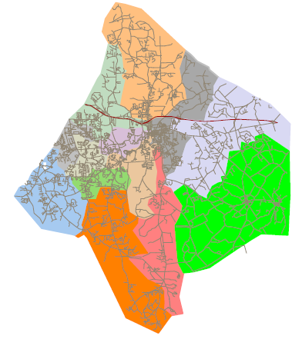
2010-11 Elementary Zones
Notes:
Based on residential addresses not school attending.
Numbers reflected in presentation are based on current boundary #s and proposed 11-12 #s.
Any boundaries that do not presently exist will show 0 for current school year.
Any boundaries that will not be in use 11-12 school year will not be listed with current enrollment #s.

Slide 10
New Elementary school #15
Student Demographics
(Ethnicity)

Slide 11
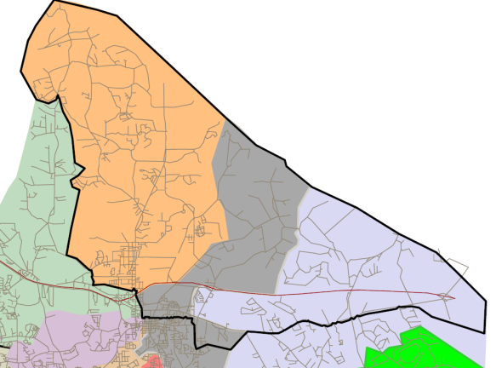

New Elementary school #15
Building Capacity |  |  |  | 1500
2010-11 Enrollment |  |  | 2011-12 Enrollment
PK | 0 |  | PK | 92
K | 0 |  | K | 203
1 | 0 |  | 1 | 187
2 | 0 |  | 2 | 205
3 | 0 |  | 3 | 189
4 | 0 |  | 4 | 184
5 | 0 |  | 5 | 204
Total | 0 |  |  | 1264
Notes:
2010-11 Palmer Stone Boundary
Portion of Ficquett slightly south of 278
East Newton north of 278

Slide 12
East newton
Student Demographics
(Ethnicity)

Slide 13
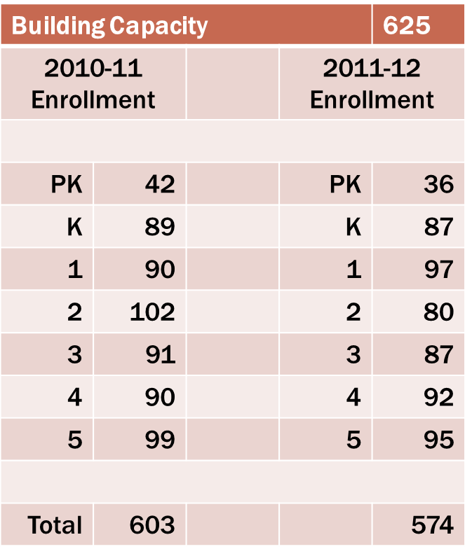
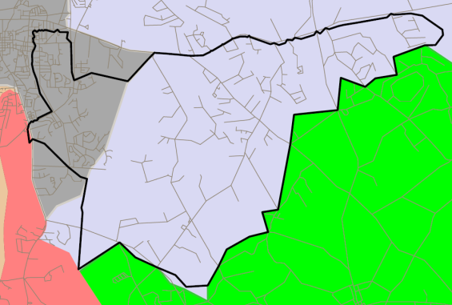
East Newton

Slide 14
Fairview
Student Demographics
(Ethnicity)

Slide 15
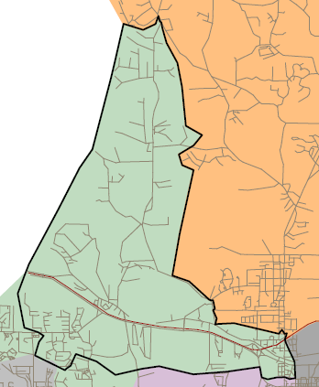
Fairview
Building Capacity |  |  |  | 600
2010-11 Enrollment |  |  | 2011-12 Enrollment
PK | 0 |  | PK | 31
K | 0 |  | K | 83
1 | 0 |  | 1 | 91
2 | 0 |  | 2 | 100
3 | 0 |  | 3 | 87
4 | 0 |  | 4 | 92
5 | 0 |  | 5 | 85
Total | 0 |  |  | 569
Notes:
Northern portion of LOES

Slide 16
Heard-mixon
Student Demographics
(Ethnicity)

Slide 17
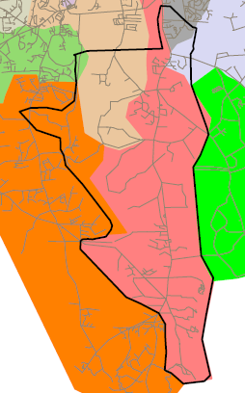
Heard-Mixon
Building Capacity
2010-11 Enrollment | 467
2011-12 Enrollment | 468
Building Capacity |  |  |  | 500
2010-11 Enrollment |  |  | 2011-12 Enrollment
PK | 34 |  | PK | 31
K | 69 |  | K | 75
1 | 79 |  | 1 | 72
2 | 68 |  | 2 | 66
3 | 86 |  | 3 | 80
4 | 71 |  | 4 | 76
5 | 60 |  | 5 | 68
Total | 467 |  |  | 468
Notes:
ENES (primarily commercial Piper Rd area)
Upper east side of RPES
Southern portion of MRES
Eastern tip of LVES

Slide 18
LIVE OAK
Student Demographics
(Ethnicity)

Slide 19
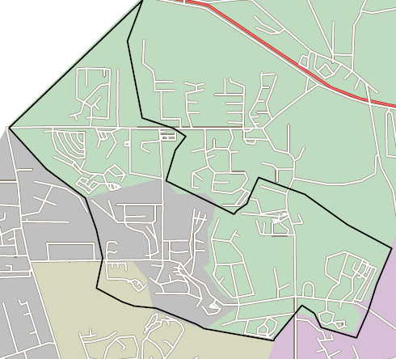
Live Oak
Building Capacity |  |  |  | 1000
2010-11 Enrollment |  |  | 2011-12 Enrollment
PK | 72 |  | PK |  | 58
K | 185 |  | K |  | 133
1 | 182 |  | 1 |  | 128
2 | 194 |  | 2 |  | 131
3 | 183 |  | 3 |  | 146
4 | 221 |  | 4 |  | 169
5 | 197 |  | 5 |  | 160
Total | 1234 |  |  |  | 925
Notes:
Remaining LOES not FVES
Northeastern corner of WNES
Small area of SSES

Slide 20
LIVINGSTON
Student Demographics
(Ethnicity)

Slide 21
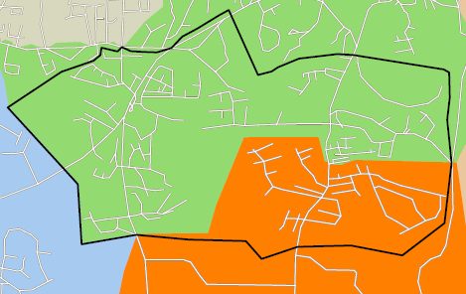
Livingston
Building Capacity |  |  |  | 625
2010-11 Enrollment |  |  | 2011-12 Enrollment
PK | 42 |  | PK | 38
K | 85 |  | K | 67
1 | 88 |  | 1 | 83
2 | 94 |  | 2 | 91
3 | 105 |  | 3 | 85
4 | 100 |  | 4 | 96
5 | 109 |  | 5 | 100
Total | 623 |  |  | 560
Notes:
Northern portion of RPES

Slide 22
Mansfield
Student Demographics
(Ethnicity)

Slide 23
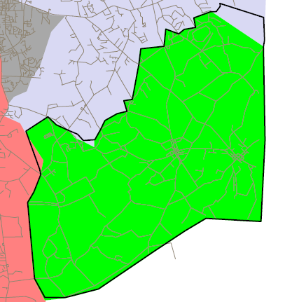
Mansfield
Building Capacity |  |  |  | 500
2010-11 Enrollment |  |  | 2011-12 Enrollment
PK | 38 |  | PK | 38
K | 76 |  | K | 76
1 | 63 |  | 1 | 63
2 | 72 |  | 2 | 72
3 | 81 |  | 3 | 81
4 | 82 |  | 4 | 82
5 | 75 |  | 5 | 75
Total | 487 |  |  | 487
Notes:
Enrollment does not change but boundary is drawn to take in any new development in the northeast portion of ENES

Slide 24
MIDDLE RIDGE
Student Demographics
(Ethnicity)

Slide 25
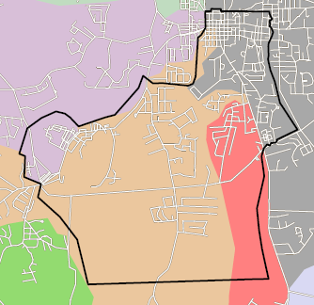
Middle Ridge
Building Capacity |  |  |  | 800
2010-11 Enrollment |  |  | 2011-12 Enrollment
PK | 43 |  | PK | 62
K | 90 |  | K | 116
1 | 83 |  | 1 | 125
2 | 87 |  | 2 | 113
3 | 89 |  | 3 | 119
4 | 90 |  | 4 | 120
5 | 94 |  | 5 | 106
Total | 576 |  |  | 761

Slide 26
Oak Hill
Student Demographics
(Ethnicity)

Slide 27
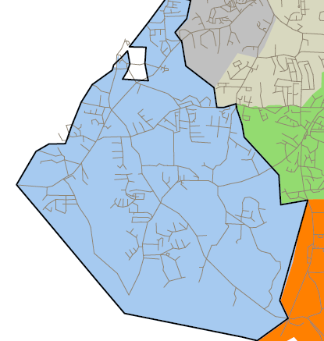
Oak Hill
Building Capacity |  |  |  | 800
2010-11 Enrollment |  |  | 2011-12 Enrollment
PK | 49 |  | PK | 49
K | 127 |  | K | 127
1 | 124 |  | 1 | 124
2 | 102 |  | 2 | 102
3 | 100 |  | 3 | 100
4 | 140 |  | 4 | 140
5 | 119 |  | 5 | 119
Total | 761 |  |  | 761
Notes:
No major changes

Slide 28
Porterdale
Student Demographics
(Ethnicity)

Slide 29
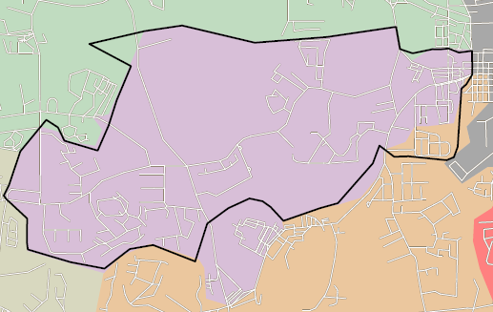
Porterdale
Building Capacity |  |  |  | 550
2010-11 Enrollment |  |  | 2011-12 Enrollment
PK | 40 |  | PK | 37
K | 84 |  | K | 83
1 | 82 |  | 1 | 80
2 | 80 |  | 2 | 78
3 | 90 |  | 3 | 87
4 | 69 |  | 4 | 64
5 | 99 |  | 5 | 97
Total | 544 |  |  | 526
Notes:
Small area of MRES

Slide 30
ROCKY PLAINS
Student Demographics
(Ethnicity)

Slide 31
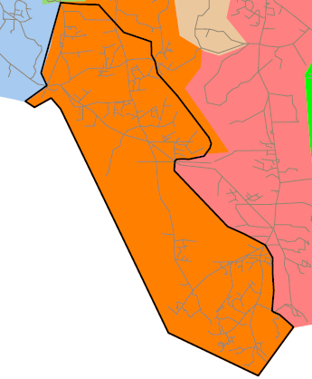
Rocky Plains
Building Capacity |  |  |  | 800
2010-11 Enrollment |  |  | 2011-12 Enrollment
PK | 61 |  | PK | 42
K | 142 |  | K | 111
1 | 164 |  | 1 | 128
2 | 157 |  | 2 | 117
3 | 164 |  | 3 | 126
4 | 151 |  | 4 | 104
5 | 179 |  | 5 | 139
Total | 1018 |  |  | 767

Slide 32
South Salem
Student Demographics
(Ethnicity)

Slide 33
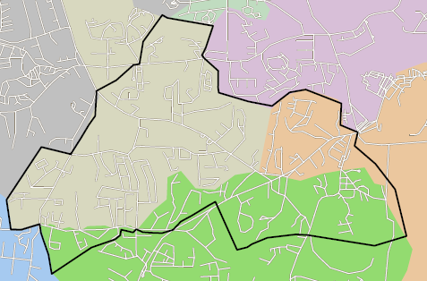
South Salem
Building Capacity |  |  |  | 1000
2010-11 Enrollment |  |  | 2011-12 Enrollment
PK | 52 |  | PK | 60
K | 125 |  | K | 147
1 | 133 |  | 1 | 143
2 | 140 |  | 2 | 165
3 | 135 |  | 3 | 166
4 | 131 |  | 4 | 136
5 | 144 |  | 5 | 166
Total | 860 |  |  | 983
Notes:
West end of MRES
Northern portion of LVES (including Oak Hill Rd., portion of 81 and 162)

Slide 34
WEST NEWTON
Student Demographics
(Ethnicity)

Slide 35
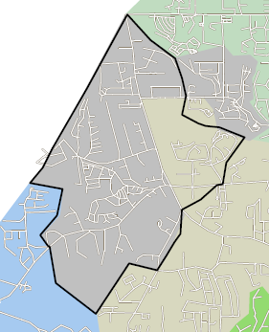
West Newton
Building Capacity |  |  |  | 800
2010-11 Enrollment |  |  | 2011-12 Enrollment
PK | 44 |  | PK | 44
K | 108 |  | K | 111
1 | 120 |  | 1 | 122
2 | 125 |  | 2 | 123
3 | 115 |  | 3 | 99
4 | 114 |  | 4 | 126
5 | 128 |  | 5 | 119
Total | 754 |  |  | 744
Notes:
Northeastern portion of SSES

Slide 36

2011-12 Elementary Zones

Slide 37
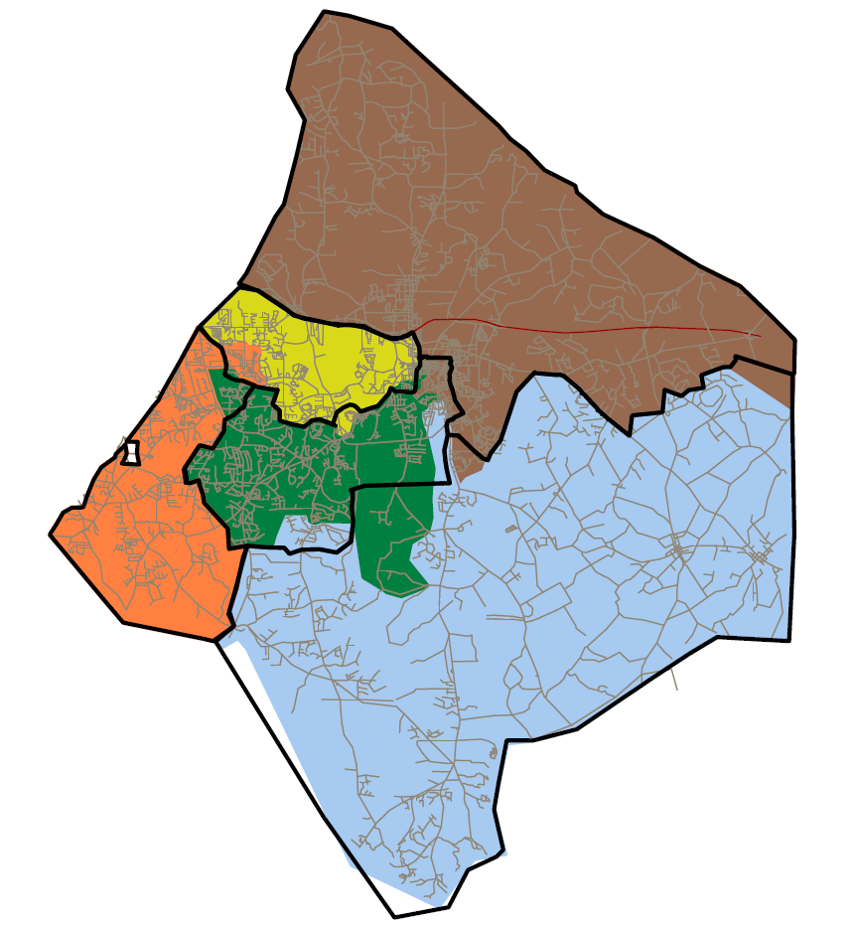
2011-12 Middle School feeder pattern

Slide 38
Questions and answers

